Slide 1
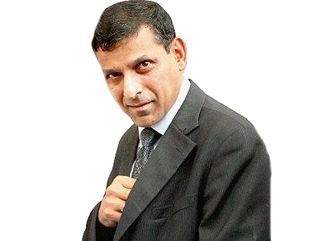
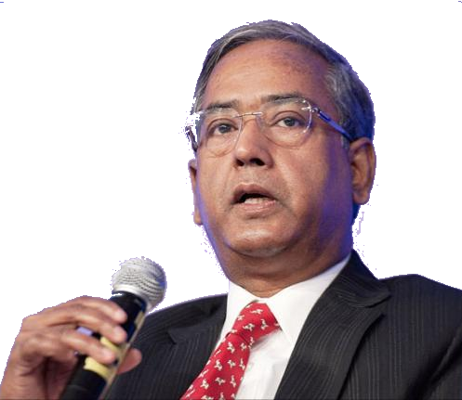
Crisis periods getting shorter, we’ve to brace up
P2P lending
Deepening Corporate Bond market
P-Notes KYC

Slide 2
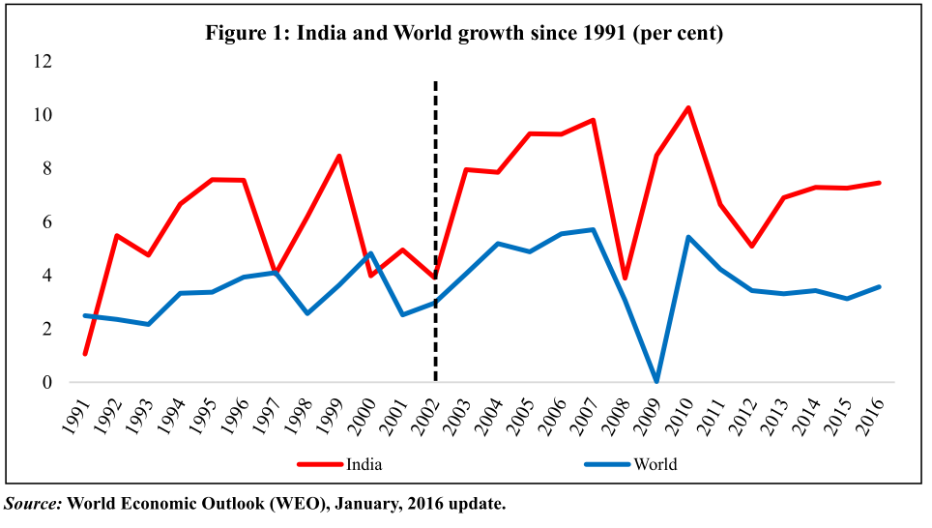
India’s fate linked with World’s fate

Slide 3
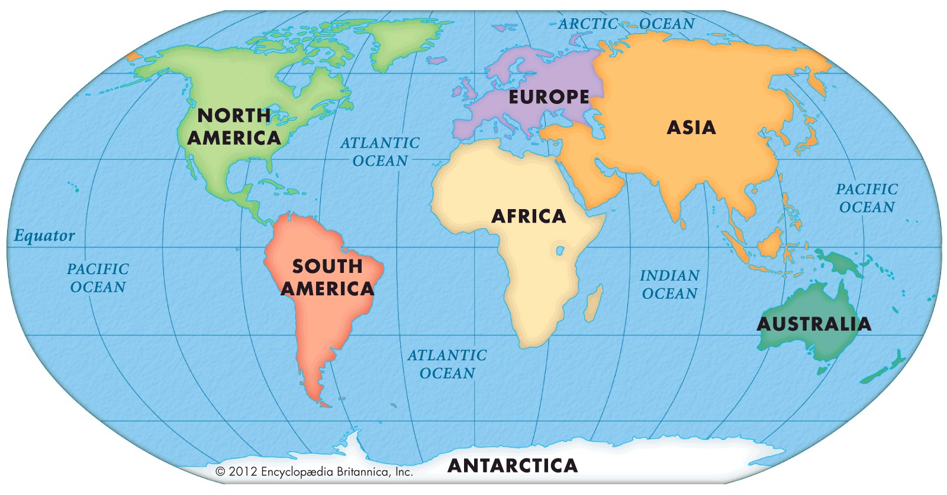
Financial crisis
2008: East Europe
2008-13: Eurozone, Greece Debt.
2015: China stock exhange
2008: Subprime
97s: East Asian
82: Latin America Debt crisis
Crisis occurring more frequently
India should brace up
~10 years gap between each crisis.
Fueled by foreign investment & sudden its stop

Slide 4
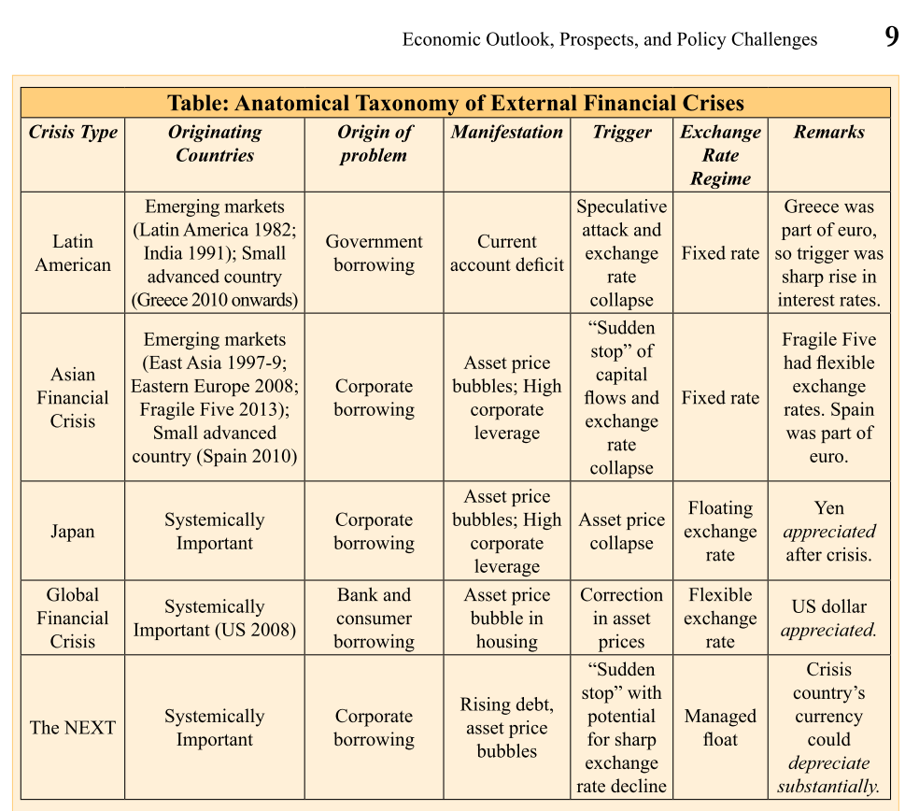
V1c1 page9 and box 1.2
Is this India??

Slide 5
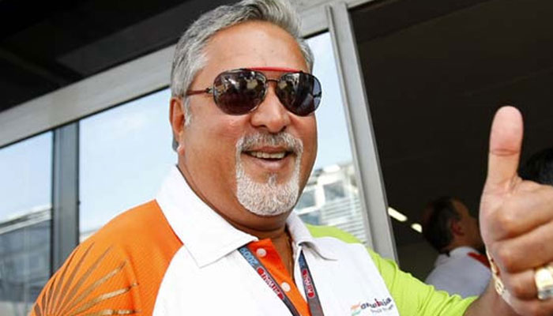
India should brace up
Area
Banking Collapse?
Doing / Done
Balance sheet clean up exercise
I&B code.
BBB, Consolidation
Deepening Corporate Bond market
P2P lending norms
Asset bubble?
Corporate borrowing?

Slide 6


Banking sector: BES161
NPA, TBS, BASEL, 4R, Indradhanush, BBB
MP Incomplete Transmission, MCLR etc.
Differential Banks
PSL-framework, Certi.

Slide 7


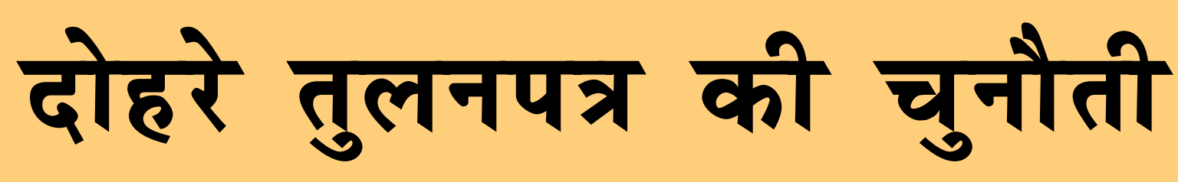
2015: Financial statements of PSBs (Rs.Crore)
MD and CEO is Usha Anantha Subraminum.
Reasons: higher provision for bad loans. -Mallya Rs.800 cr. Loan; Steel-12500 cr.; Punjab-FCI
Solutions planned: (1) war room headed by GM (2) selling PNB housing finance and other non-core companies

Slide 8
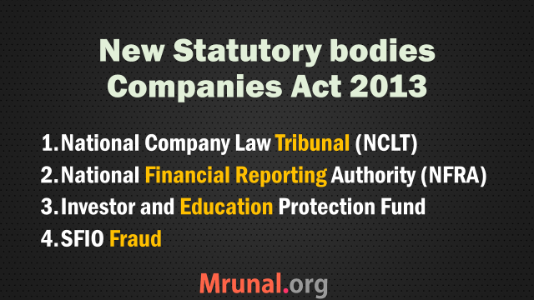
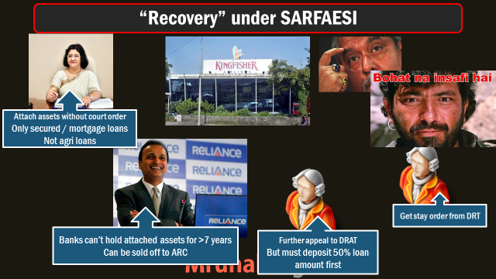
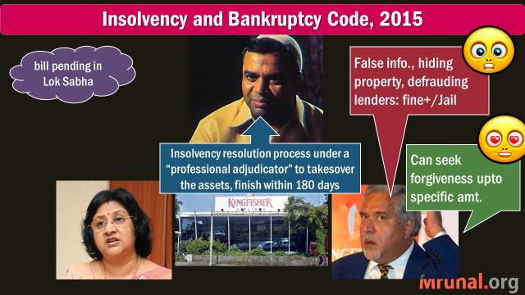
IBC-2015 Pass in Rajya Sabha
For individual,
Partnership firms
Goto DRT
For companies
NCLT
New updates
Worker dues for 24 months
Cross-border insolvency.
Notes:
Similarly, when an Indian company that has assets abroad undergoes insolvency proceedings in India, its creditors (in India and abroad) may want to prevent it from disposing of its assets abroad and have such assets included in the bankruptcy estate of the company in India. This require the Indian insolvency professional to appear before foreign courts and ask for recognition of Indian insolvency proceedings. The Indian debtor, on the other hand, may want to have a stay on all legal proceedings against it in the relevant foreign jurisdiction so that insolvency proceedings in India take place in an orderly fashion.

Slide 9
Monetary policy Committee immediately after Fin. Bill is passed
RBI (3)
Gov
Government (3)
Experts in economics, banking, finance, monetary policy
Dy.Gov
Xo Dir.
Search cum selection Committee
Cabinet Secretary
Rajan
Secretary Economic Affairs

Slide 10
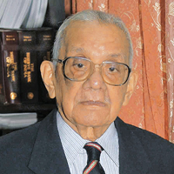
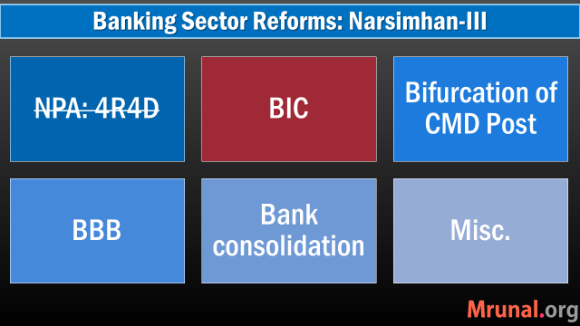
Banking sector Reforms: Narsimhan-III ?
RBI’s P.J.Nayak Committee 2014 BIC, BBB
Indradhanush 2015-Aug,
Dept. Financial services
Gyan Sangam-II Gurgaon-2016 Bank Consolidation
Gyan Sangam-I Pune-2015, Jan BBB
Appointments- CMD bifur.
Bank Board Bureau
Capitalization
De-stressing PSBs
Empowerment
Framework of Accountability
Governance Reforms
Narsimhan I & II
Self study: L1/P7
Notes:
Guru Dronacharya; the village was given as “gurudakshina” to him by his students, the Pandavas,

Slide 11

SBI owns ~75% to 100% in each of these banks
1913: Mysore
Maharaja of Mysore on M.Vishweshwariah (Bharat Ratna) Committee
40s: Bikaner & Jaipur
1917: Patiyala
1941: Hyderabad
Maharaja Bhupinder Singh
Nizam Mir Osman Ali Khan; Also issued Osmania Sicca
‘48: Operation Polo.
43: Jaipur; 44: Bikaner ► 63: merged
1945: Travancore
Diwan of Travancore, Kerala
MERGED
2008: Saurashtra
2010: Indore
73% falls in Q3-2015
SBI owns 90% shares
Listed @Bombay Stock Exchange
Notes:
As of now Total PSB
21 PSB (incl.Mahila)+1 SBI +5 asso = 27

Slide 12
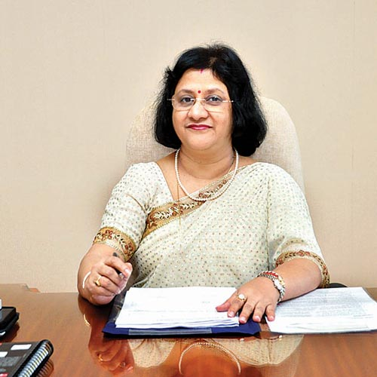
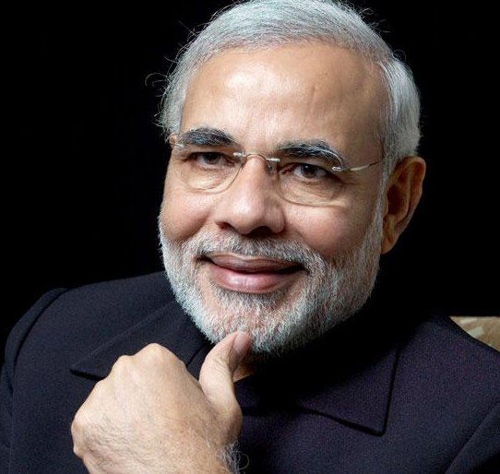

MD, Hyderabad
MD, Bik | Jaipur
MD, Travancore
MD, Mysore
SBI Chairman
MD, Patiyala
Even if I merge, group’s balancesheet will not go up. Hence not in priority but someday we’ll.
-Arundhati Bhattacharya (2015)
SBI MD: VG Kannan
Announced plans to merge 5 asso. Banks + Bharatiya Mahila Bank. -2016 May
SBI Act Sec. 35/1 – with Govt approval it can merge.
Notes:
Subsidiary banks?

Slide 13
SBI Bank consolidation
Pro
All asso. posted losses
Anti
Strained balance sheet.
Streamlining operational efficiency.
Streamlining customer accounts, netbanking, HR, etc. will take one year
Bank employee union opposed
Can finance corporate, even their overseas acquisition
Alleviate BASEL capital req. (BES161/P4)
Merger = 1% cheaper loans in a year (Arundhati Bhattacharya)

Slide 14

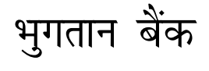
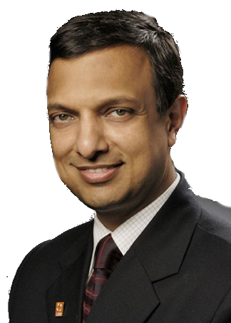
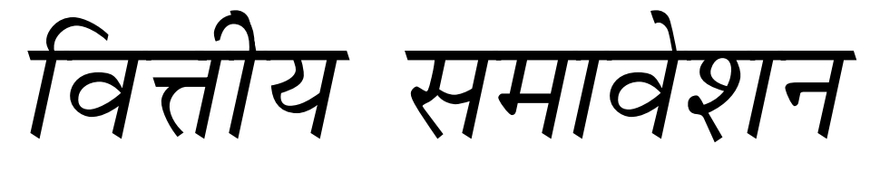
Differential Banks
Small F.Banks
Payment Banks
Wholesale Banks
Custodian Banks
RBI’s Nachiket Mor Committee on Financial inclusion (2014) Suggested Differential Banks /Niche banking

Slide 15
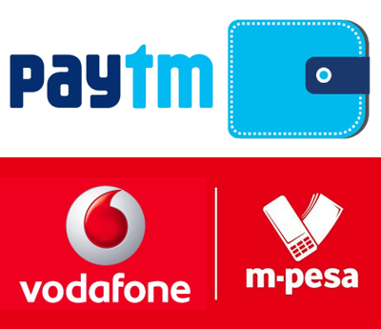
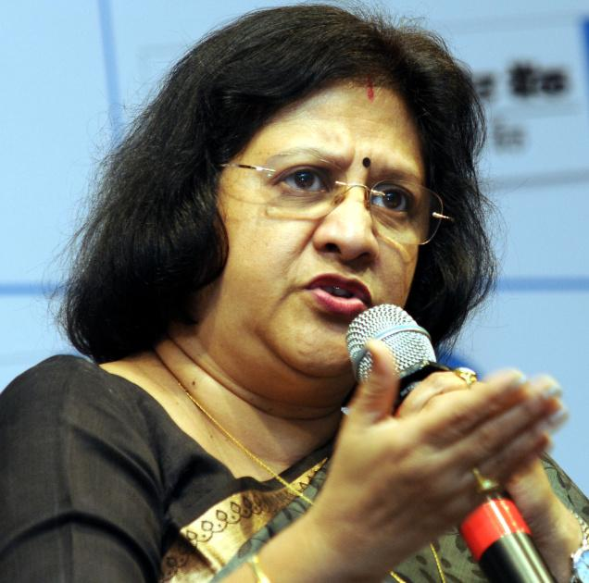
3 out 11 payment banks: gone with the wind
Dilip Shanghvi (Sun Pharma)- Telenor & IDFC
Cholamandalam Distri. Services Ltd (Murugappa group)
Tech Mahindra Ltd
Department of Posts
Fino PayTech Ltd (backed by IFC-W.Bank)
Reliance Industries Ltd (Mukesh+SBI)
Vijay Shekhar Sharma (Paytm)
Vodafone m-pesa (tied with ICICI)
Aditya Birla Nuvo Ltd (with IDEA)
Airtel M Commerce Services Ltd (with Kotak Mahindra Bank)
National Securities Depository Ltd
WITHDREW
Too many players, razer-thin profit margin
Payment banks don’t have viable business model, YET

Slide 16
India should brace up
Area
Asset bubble?
Doing / Done
Balance sheet clean up exercise
I&B code.
BBB, Consolidation
Deepening Corporate Bond market
P2P lending norms
Banking Collapse?
Corporate borrowing?

Slide 17




What is P2P Lending?
Seller
Buyer
Borrower
Lender
Used goods
Loans

Slide 18
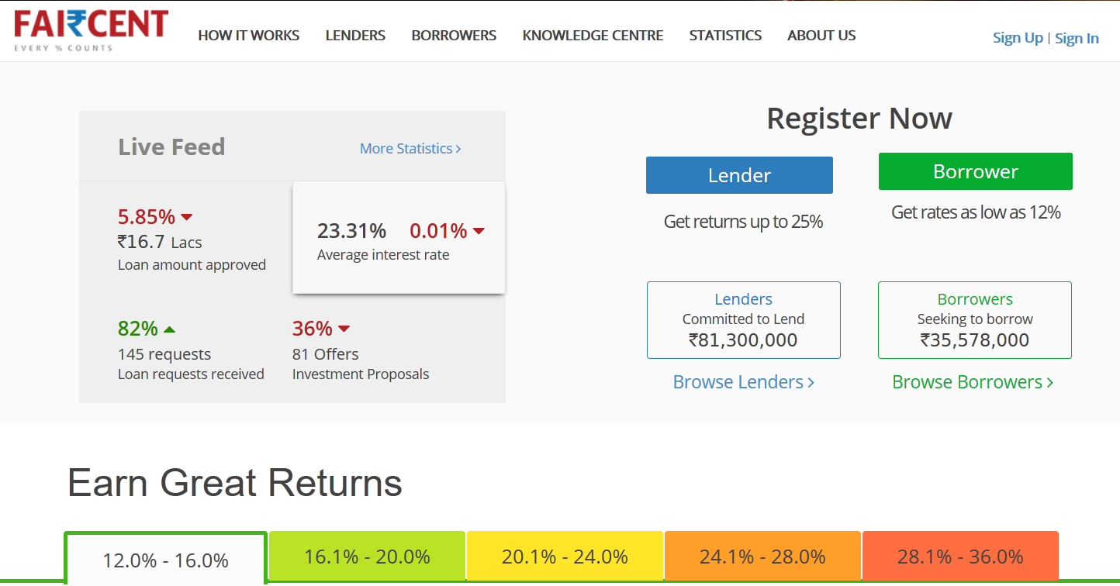
P2P Lending

Slide 19
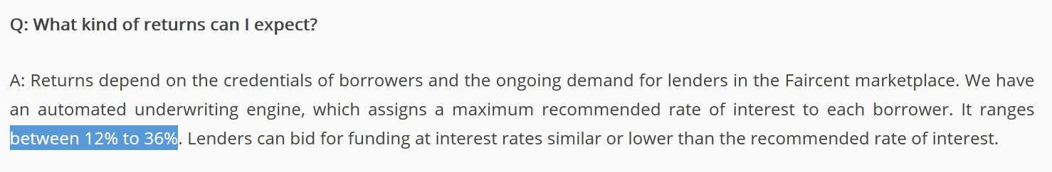
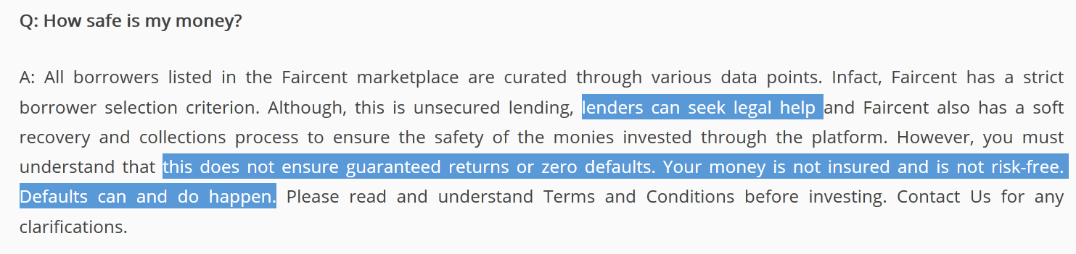
Risks and rewards associated

Slide 20
P2P lending
RBI norms
RBI consultation paper guidelines. ~30 startup P2P companies in India.
Min. 2 cr .capital required to setup this type of company.
Some of the Board members must have background in Finance.
Unsecured loans only.
Money must directly go from lender to borrower's bank account to avoid money laundering.

Slide 21
P2P lending
It’s an exclusive online mechanism by MUDRA Bank to connect MFIs with borrowers
P2P Loans are protected under SARFAESI
P2P Lending falls under exclusive regulatory domain of SEBI.
Find Correct Statement(s)
A): Only 1 and 2; B): Only 2 and 3;
C): Only 1 and 3; D): None of them

Slide 22

Financial Market
P2P lending
Deepening Corporate Bond market
P-Notes KYC
Stressed Balance sheet, BASEL-III
Revival through C-Bonds ► NPA recovery

Slide 23
deepen corporate bond market
SEBI
e-auction platform for C-Bonds
RBI
Repo market for C-Bonds
RBI + SEBI
information repository for corporate bonds, covering both primary and secondary market segments
Budget-2016

Slide 24
deepen corporate bond market
LIC separate fund► credit enhancement to infra projects. (aka accepted Survey-2014)
New credit rating system for infra. Projects, so loans can be rightly priced.
Infra. project rating improve► cheaper to borrow through bonds
MORE MEASURES: IYB-2016 Page 353 (mostly for mains)
Budget-2016
Notes:
Quote PDPU
Deepening Corporate bond market
LIC of India will set up a dedicated fund to provide credit enhancement to infrastructure projects
The fund will help in raising the credit rating of bonds floated by infrastructure companies and facilitate investment from long term investors.
RBI will issue guidelines to encourage large borrowers to access a certain portion of their financing needs through market mechanism instead of the banks.
SEBI
e-auction platform for C-Bonds
RBI
Repo market for C-Bonds
RBI + SEBI
information repository for corporate bonds, covering both primary and secondary market segments

Slide 25
SME platform
(already) The small and medium enterprises (SME) platform
Stock exchange for companies
With paid up capital not more than 25 cr.

Slide 26

Budget 2015: National Investment and Infrastructure Fund (NIIF)
Government
Rs. 20k cr
Financially viable
Fund of the funds
AIF Cat-II
fund1
Greenfield
fund2
Brownfield
Rs.40k
Crores
Other sources
Rs. 20k cr
fund3
Under Indian trust act, Dept of Economic affairs
Notes:
Government stakes will not >49%

Slide 27
SEBI classification- alternative investment fund (AIF)
AIF Cat1 (GOOD)
Angel investors, venture capital funds, SME, infra. Funds
AIF Cat2 (MIXED)
AIF Cat3 (BAD)
Not in cat. 1 or 2
Hedge fund: high risk high reward using complex trading & leverage strategies
e.g. NIIF, debt funds
Socially, economically desirable
Whether good or bad for economy
Budget 2016
Withholding tax provision tweaked, so those from DTAA countries can’t misuse

Slide 28
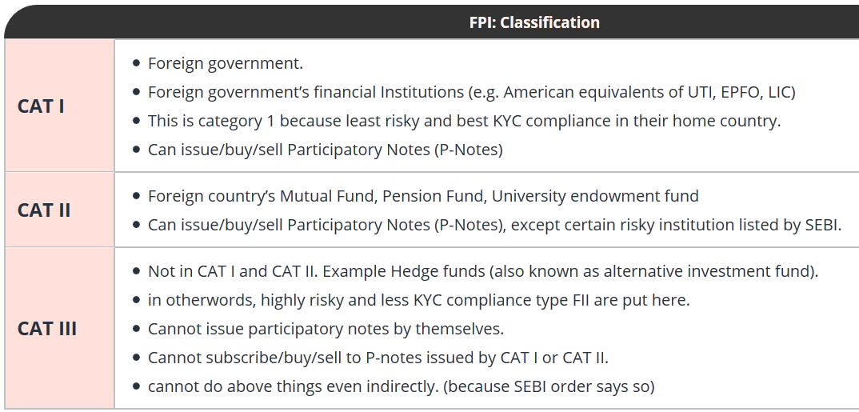
SEBI classification- FPIs
Risk based approach to customer identity

Slide 29
Financial Market
P2P lending
Deepening Corporate Bond market
P-Notes KYC
Stressed Balance sheet, BASEL-III
Revival through C-Bonds ► NPA recovery

Slide 30









P-Note: Offshore Derivative Instrument
Offshore Investor
Without PAN card, DEMAD account
or SEBI Registration
Shares
bonds
SEBI registered
FII (India)
Tom can sell
P-note to others without paying capital gains tax
to India
P-Note
Derives value from
FII portfolio
FII’s portfolio
Notes:
Since 1992 FII permitted
ultimate beneficial owners of ODIs (offshore derivative instruments) being Cayman Islands, the US, the UK, Mauritius and Bermuda contributing 31.31 per cent, 14.20 per cent, 13.49 per cent, 9.91 per cent and 9.10 per cent

Slide 31
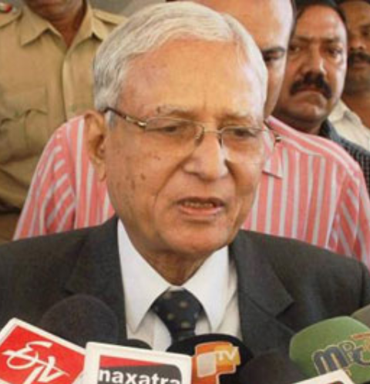
P-Notes Bad because
SC-SIT
>2 lakh crore invested via P-Notes.
Stock rigging, Hot-money
terror finance, money laundering and tax avoidance.
SIT wanted stricter control, KYC.
SEBI implemented.
Retd. Justice M.B.Shah
SEBI Chief UK Sinha

Slide 32
P-Notes: SEBI’s new norms 2016, May
ISSUER
Either Foreign
Indian KYC norms apply.
SEBI registered
FII (India)
Inform issuer before selling/transferring P-Notes
Report monthly transactions
Review high risk accounts once a year, alert FIU if required
Notes:
He’’ll prefer tax haven because foreign KYC.
FIU- financial intelligence unit.

Slide 33
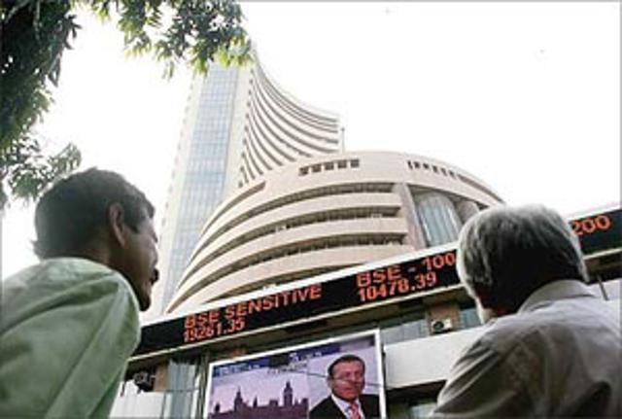
India should brace up
Area
Hot money, flight of capital, Share market collapse?
Doing / Done
SEBI P-Notes KYC
India Mauritius DTAA tightened

Slide 34
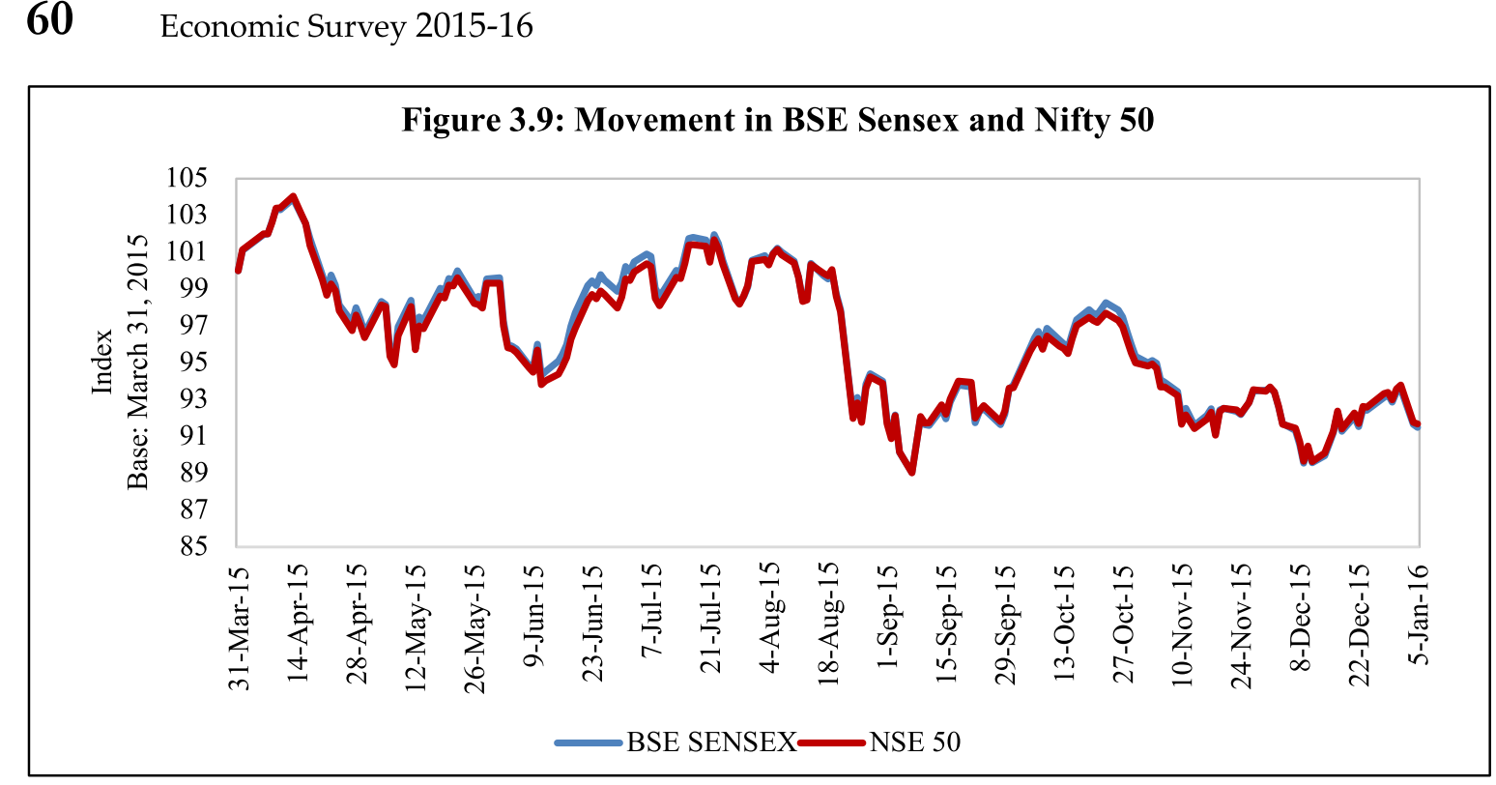
Performance of Indian stock market?
FPI worried on MAT
Thanks to China
US Fed Rate Hike
US Fed Rate Hike
▲Bond Yield in 1st world
Q3 Reports: Banks Losses
Corporates Mixed earning
Mauritius DTAA
SEBI P-Notes KYC
Notes:
Subdued performance, BSE down by 8.5%
Reasons: Aug-15: China Black Monday, currency devaluation, global turmoil
Mixed corporate earnings
GST Delay
FPI concerned over MAT
Increase in crude oil prices
LATEST: after amendments in India-Mauritius DTAA- to impose CGT.

Slide 35
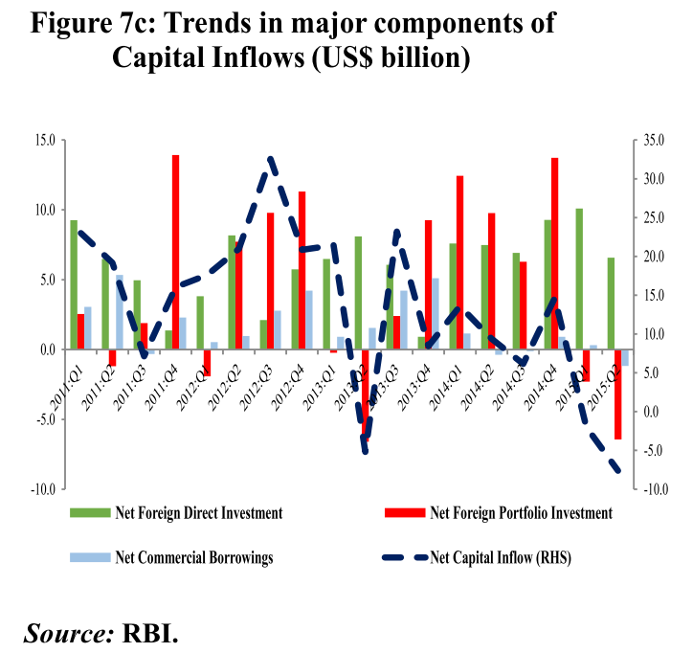
India should brace up
Area
FDI / FII may ▼
Foreign demand may ▼
Should do
Create domestic demand
Declined crude prices should help combating inflation
Easy money policy; Tax Reliefs

Slide 36
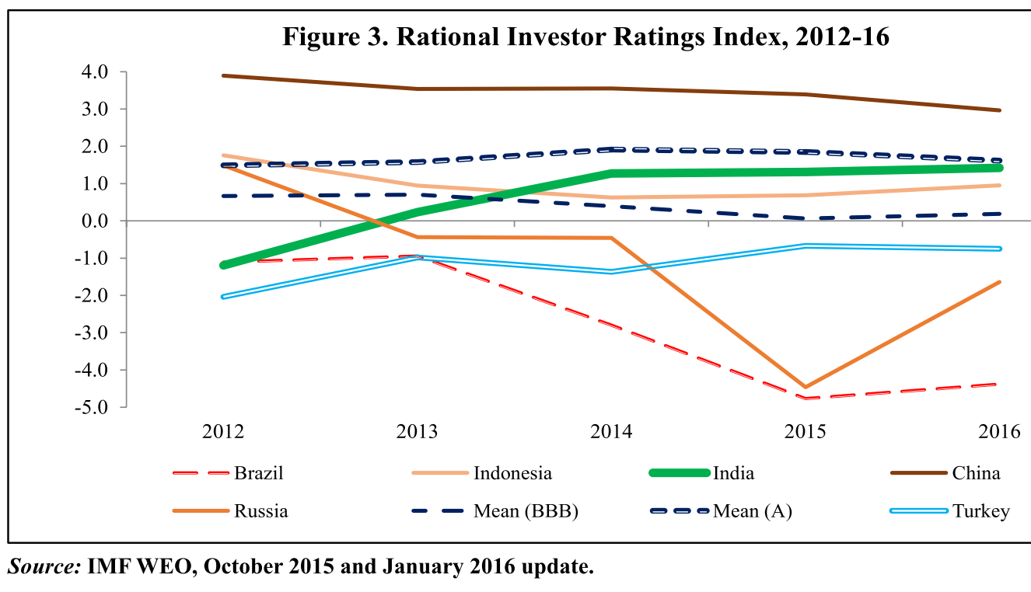
Foreigner Investors PoV: As such India doesn’t suck
China share market
Dilma Rousseff
Pursue Ease of Doing, Relax FDI
Ease of Taxation, MAT, GAAR, PoEM
Public investment in infra, Smart Cities
Finance inclusion, JAM, BAPU
HRD: BBBP, SBA

Slide 37
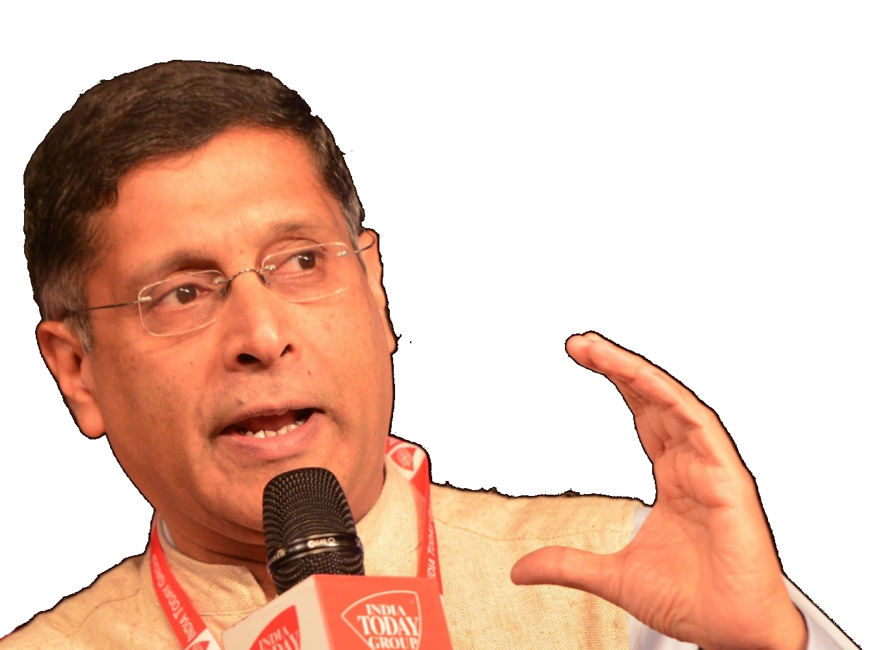
Banking done/will be done
FS reforms
Indradhanush, BBB
*MPC; I&B code ; Will strengthen DRT, SARFAESI
*RBI to felicitate Retail participation in G-Sec
*ATM, Micro ATMs in Post offices
*New law against illicit deposit schemes
DICGC► Resolution Corporation for faster dispersal of deposit insurance and resolution of financial service providing companies.
* = promised in new budget

Slide 38
Financial market done/will be done
FS reforms
FMC merged (last budget)
*Will strengthen SAT
*Financial Data Management Centre under the aegis of the Financial Stability Development Council (FSDC)
*SEBI to develop new derivative products for commodity market
*Sarkari insurance cos to be listed @Stock exchange for retail accountability
* = promised in new budget

Slide 39
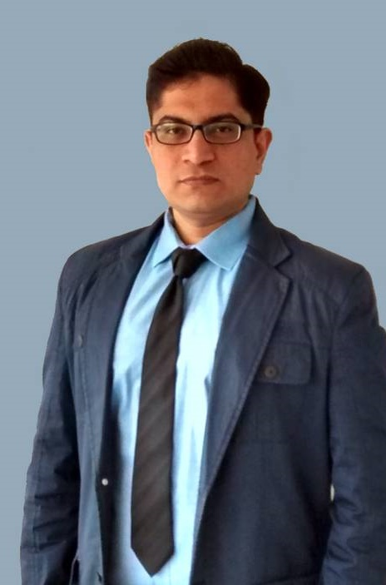
Theory +Economic Survey Vol.2 + Vol.1 + Budget 2016
1.Banking Finance
6.HRD
2.Budget-Fiscal Policy
3.BoP
4.Sectors of Economy
5.Infra
V2C2-Pub.Fin; V1C3-JAM
V2C3-Monetary mgmt+FI
V2C4-External sector
V2C5-Price,Agri.; V2C6,7
V2C8-Paris Summit, Energy
V2C9-Social infra.
V1C4-Agri ; V1C9-Fertilizer
V1C5-mother-child
V1C6-bounties; V1C7-Fiscal Cap
V1C8-PTA
V1C2-Chakravy; V1C10-Labour
V1C11-Powering 1 India
B1. Financial Sector Reforms
B2. Fiscal Discipline
B3. Tax Reforms; B4. Ease of
B5. Agro: 2x farmer income
B6. Rural infra-employment
B7. Infrastructure
B8. Social Sector & healthcare
B9. Education, Skills, Jobs
V2C1- Chakravyuh challenge
V1C1- Twin Balancesheet
IYB:7-Commerce

Slide 40
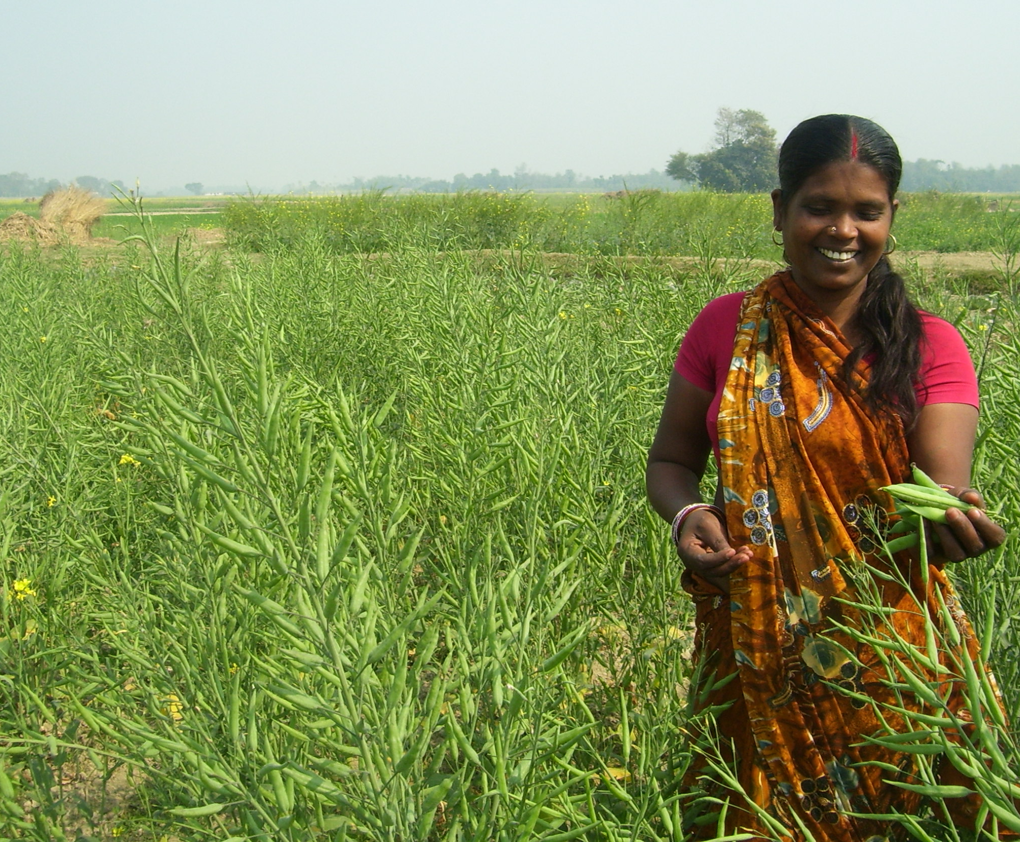
Next Time ► Pillar #4: Sectors of Economy ► Agriculture
Seeds, Irrigation, Fertilizer, Pesticides
Diversify
Credit, Insurance, Marketing
Husbandry
More from Less
$$
organic, pulses

Slide 41
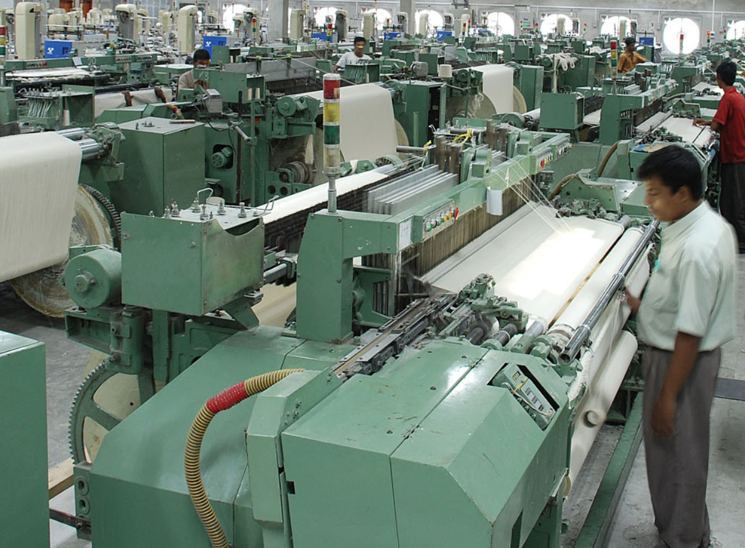
Next Time ► Pillar #4 ► Sectors of Economy ► MFG
Types- employment
DPP-2016
Textile Shift
Startups
Regulatory Cholesterol

Slide 42
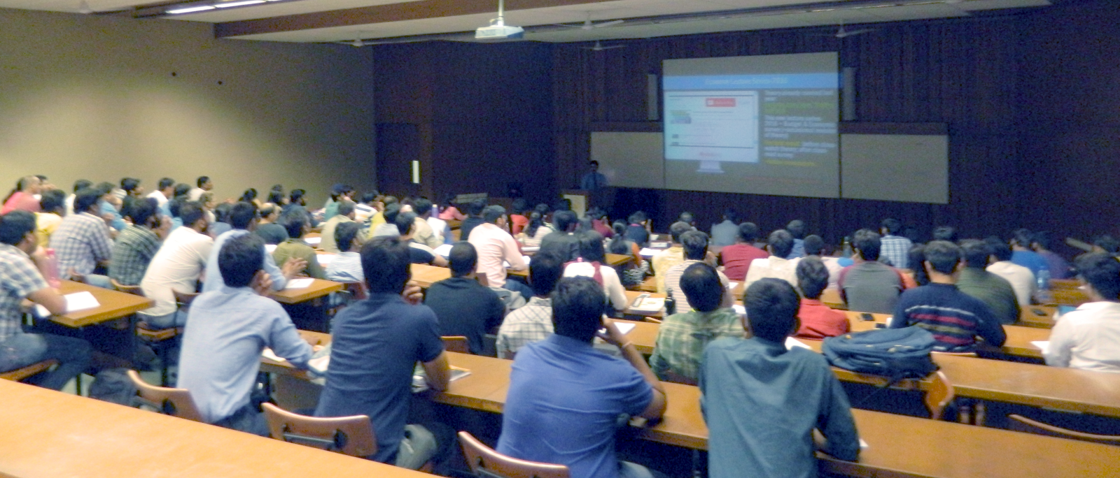
For best results..
After Today’s Lecture
Self study After Today’s Lecture
V2C4-External sector
V1C8-PTA
IYB-2016 Ch. 7, 13
Before next lecture
Go through past theory videos:
Economy: “L5/P1 to P7”
Geography: “G7 & G8 series”
youtube.com/user/TheMrunalPatel
+ Daily English newspaper: Hindu (1st Preference) OR Indianexpress

